Slide 1
Module 2: Mandated Tasks of United Nations Peacekeeping Operations
Lesson
2.7
Child Protection

Slide 2
Relevance
Peacekeeping personnel:
Protect children’s human rights
Protect children from violence
UN Core Pre-Deployment Training Materials 2017

Slide 3
Learning Outcomes
Learners will:
Define a “child”
Explain why children need special protection, especially in armed conflict
Describe duties of peacekeeping personnel as reflected in UN policies
List actions to take to protect children
UN Core Pre-Deployment Training Materials 2017

Slide 4
Lesson Overview
Definitions
Importance of Attention to Children & Armed Conflict (CAAC)
UN Partners Leading in Addressing CAAC
Legal Framework
DPKO-DFS Policies on Child Protection
Child Protection in UN Peacekeeping
Roles & Responsibilities
What Individual Peacekeeping Personnel Can Do
UN Core Pre-Deployment Training Materials 2017

Slide 5
Learning Activity
2.7.1
Film: A Child’s Fate – Child Protection and Peacekeeping
Instructions:
How does armed conflict impact children?
Why is it important to protect children?
Time: 15 minutes
Film: 12:22 minutes
Wrap-up: 2 minutes
https://www.youtube.com/watch?v=gNFnRlGPzSM
UN Core Pre-Deployment Training Materials 2017

Slide 6
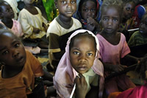
1. Definitions
A child is every boy or girl under the age of 18
The aim of Child Protection is to protect children from violence, abuse and neglect, and promote their rights
UN Core Pre-Deployment Training Materials 2017

Slide 7
Learning Activity
2.7.2
Age and Vulnerability
Instructions:
Think about your childhood or your children’s
Identify needs and milestones in development at 0-3 years, 4-6 years, 7-12 years,13-18 years
Reflect on the vulnerability of children in armed conflict at these different ages
Time: 5 minutes
Brainstorming: 3 minutes
Discussion: 2 minutes
UN Core Pre-Deployment Training Materials 2017
Notes:
CPTM 3.5.2

Slide 8
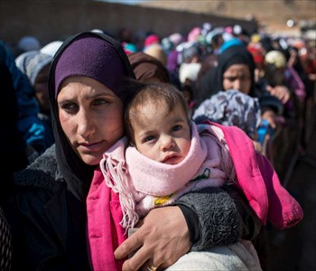
2. Importance of Attention to
Children and Armed Conflict (CAAC)
Special Protection for Children
Easily influenced
Depend on structures for protection care
Process of growing up
UN Core Pre-Deployment Training Materials 2017

Slide 9
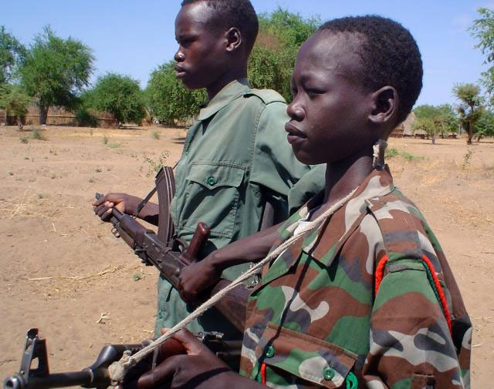
Six Grave Violations against Children’s Rights in Situations of Armed Conflict
Killing and maiming
Recruitment and use of children
Abduction
Sexual violence
Attacks against schools and hospitals
Denial of humanitarian access
UN Core Pre-Deployment Training Materials 2017

Slide 10
Learning Activity
2.7.3
Risks to Children during Armed Conflict
Instructions:
Consider the testimonies of children
Why are they at risk?
How does being a child increase their vulnerability?
Does gender play a part?
Time: 10 minutes
Brainstorming: 5-7 minutes
Discussion: 3 minutes
UN Core Pre-Deployment Training Materials 2017
Notes:
CPTM 3.5.2

Slide 11
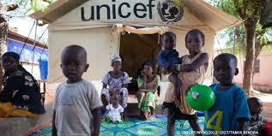
3. UN Partners Leading in CAAC
Office of the Special Representative of the Secretary-General for Children and Armed Conflict (OSRSG-CAAC)
The United Nations Children’s Fund (UNICEF)
UN Core Pre-Deployment Training Materials 2017

Slide 12
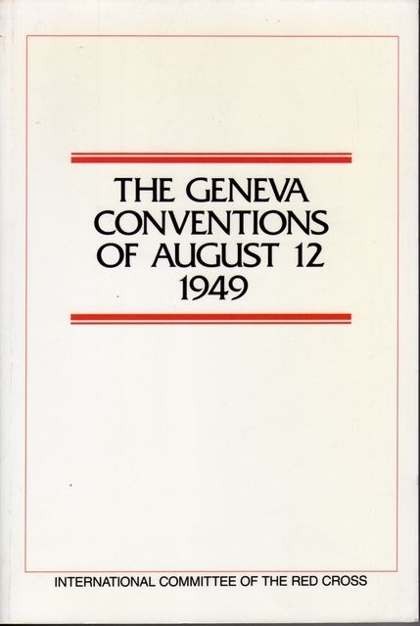
4. Legal Framework
International Law
Convention on the Rights of the Child
(CRC, 1989)
Optional Protocol to the Convention on
the Rights of the Child on the
Involvement of Children in Armed
Conflict (OPAC, 2000)
The International Labour Organization
(ILO) Convention 182 (1999)
Rome Statute of the International
Criminal Court (ICC, 1998)
Mine Ban Treaty of 1997 and
Convention on Cluster Munitions (2008)
UN Core Pre-Deployment Training Materials 2017

Slide 13
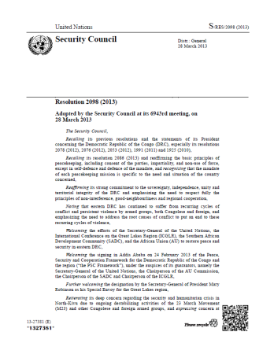
4. Legal Framework
Security Council resolutions on Children and Armed Conflict – 1612 (2005) on Monitoring and Reporting Mechanism (MRM)
UN Core Pre-Deployment Training Materials 2017

Slide 14
5. DPKO-DFS Policies on Child Protection
DPKO-DFS Policy on Mainstreaming Child Protection (2009) “DPKO shall ensure that the concerns of protection, rights and well-being of children affected by armed conflict are specifically integrated into all aspects of UN peacekeeping”. | DPKO Policy on the Prohibition of Child Labour in UN Peacekeeping Missions (2011) “The use of children under the age of 18 for the purpose of labour or rendering of services by UN peacekeeping operations is strictly prohibited”.
UN Core Pre-Deployment Training Materials 2017

Slide 15
Learning Activity
2.7.4
Obligations when Interacting with Children
Instructions:
Consider the scenarios
What should you do?
Time: 5 minutes
Brainstorming: 3 minutes
Discussion: 2 minutes
UN Core Pre-Deployment Training Materials 2017
Notes:
CPTM 3.5.2

Slide 16
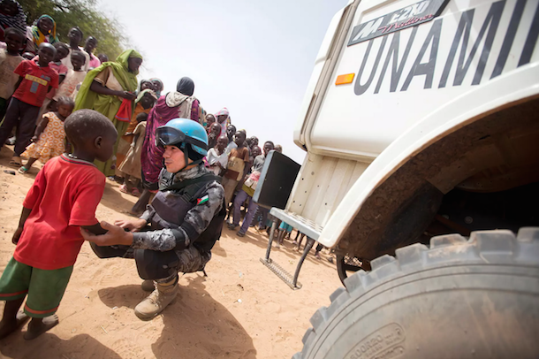
6. Child Protection in UN Peacekeeping
Alert for six grave violations
Alert to other violations:
Illegal arrest, detention
Forced displacement
Trafficking for sexual exploitation, domestic labour
Record and refer to child protection, human rights experts
UN Core Pre-Deployment Training Materials 2017

Slide 17
Coordination with Child Protection Partners
UNICEF
Other UN agencies – UNHCR, ILO, UNESCO, UNFPA
International and national NGOs
National ministries – social, health, education, youth and inter-agency groups
UN Core Pre-Deployment Training Materials 2017

Slide 18
7. Roles & Responsibilities
Child Protection Adviser (CPA)
Placing the concerns of children onto peace and political agenda
Mainstreaming, advising, training, advocating child protection
Monitoring and reporting grave violations against children
Liaising with UNICEF and other child protection partners for follow-up and response
Child Protection
Goal
UN Core Pre-Deployment Training Materials 2017

Slide 19
Other Units
DDR
Human Rights
Political Affairs
Gender Adviser
Women Protection Adviser
Civil Affairs
Rule of Law
Judicial Affairs
Corrections
SSR
Electoral
Mission Support
SRSG’s Office
UN Core Pre-Deployment Training Materials 2017

Slide 20
Special Roles of Police
Mentoring and advising
Vetting, training and advising
Investigating
Reporting
Child Protection
Goal
UN Core Pre-Deployment Training Materials 2017

Slide 21
Special Roles of Military
Protection
Contributing to alerts and information related to child rights violations
Identify and release children from armed groups
Child Protection
Goal
UN Core Pre-Deployment Training Materials 2017

Slide 22
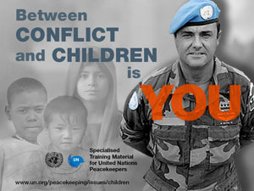
8. What Individual Peacekeeping Personnel Can Do
Identify and be alert – Six Grave Violations
Record essential information
Do not interview
Report to CPA or other experts
UN Core Pre-Deployment Training Materials 2017

Slide 23
8. What Individual Peacekeeping Personnel Can Do
Do… | Do not…
Report misconduct | Use children for any services
Keep information confidential | Interview children
Refer child survivors of violations | Take pictures of child survivors of violations
Ask CPA or CDU for guidance, if needed | Give money, food or other products to children

Slide 24
Summary of Key Messages
A “child” is an individual under 18 years
Children need special protection, especially in conflict
Duties of peacekeeping personnel – protect children, do not use children for labour or services
Take action – be alert to violations, record essential information, coordinate, intervene
UN Core Pre-Deployment Training Materials 2017

Slide 25
Questions
UN Core Pre-Deployment Training Materials 2017

Slide 26
Learning Activity
Learning Evaluation
UN Core Pre-Deployment Training Materials 2017

